Slide 1


INFORMATION SYSTEMS BASED ON IS TYPES

Slide 2
Team Members
Mohammed Alfar
20221802
Chadithya Dinuwan
20221798
03
04
05
Mohamed Juzail
20222336
Dilina Perera
20221803
02
Akash Sathiyanathan
20222330
Saad Mazhar
20221804
01
06
DOC 314 – DIGITAL SKILLS FOR HIGHER EDUCATION

Slide 3



                Introduction to KFC
              What are information systems?
            Operational support information systems
          Knowledge support information systems
        Management support information systems
      Information systems & its components
    Security threats & mechanisms to prevent them
  Summary
Q & A
CONTENTS
DOC 314 – DIGITAL SKILLS FOR HIGHER EDUCATION

Slide 4
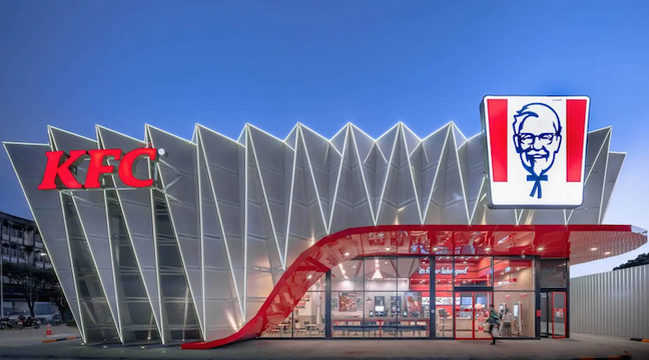
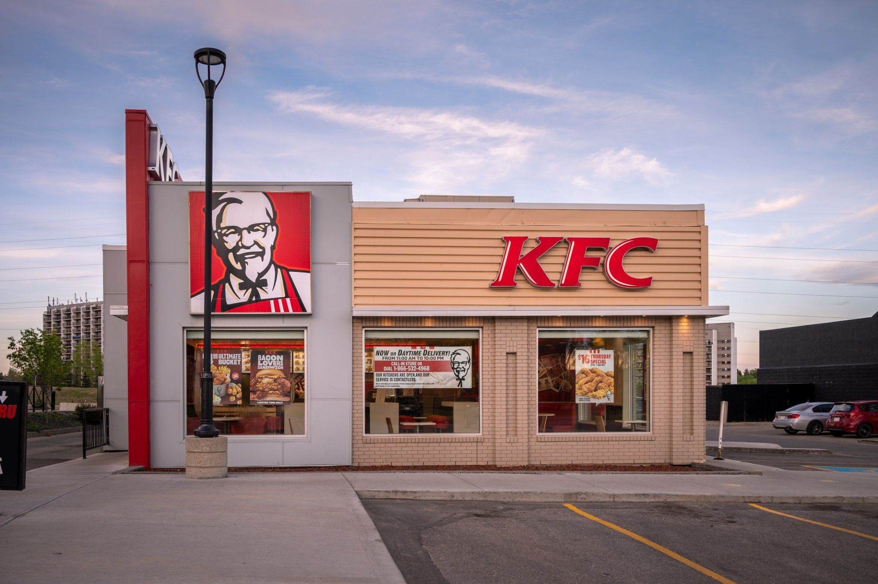
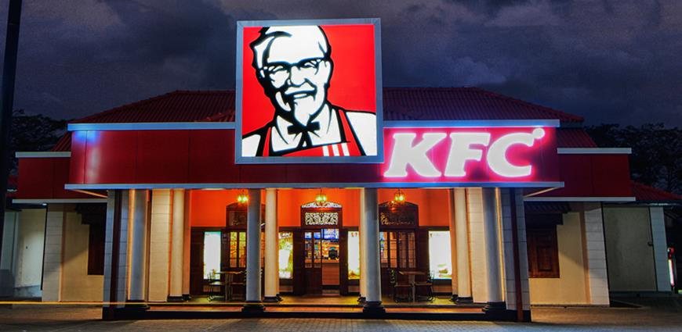


INTRODUCTION TO KFC
145
24 000
LOCATIONS
COUNTRIES
KFC (Kentucky Fried Chicken) is a global fast-food chain that is known for its fried chicken. It was founded in 1952 by Colonel Harland Sanders in Louisville, Kentucky, and has since grown to become one of the world's largest restaurant chains.
DOC 314 – DIGITAL SKILLS FOR HIGHER EDUCATION

Slide 5
WHAT ARE INFORMATION SYSTEMS?
Management
Support
Knowledge Support
Operational Support
Operational support systems are used to manage day-to-day business activities, such as sales transactions and inventory management, Management support systems are designed to support managerial decision-making and planning activities and knowledge support systems are designed to support the knowledge management activities of the organization
DOC 314 – DIGITAL SKILLS FOR HIGHER EDUCATION

Slide 6
OPERATIONAL SUPPORT INFORMATION SYSTEMS
Operational Support Information System is a type of information system that supports day-to-day operations. OSIS provides information to support routine, repetitive, and structured decisions. Examples of Operational Support Information System used in KFC are:
  Point of Sale (POS) System
  Inventory Management System
DOC 314 – DIGITAL SKILLS FOR HIGHER EDUCATION

Slide 7
01
Inventory Management System
An inventory management system is used to manage the inventory levels of raw materials, finished goods, and supplies. At KFC, an inventory management system could be used to track the inventory levels of chicken, buns, sauces, and other ingredients.
Point of Sale (POS) System
02
Point of Sale (POS) System
A POS system is used to process transactions at the restaurant. At KFC, a POS system could be used to process orders, calculate taxes, and generate receipts.
Inventory Management System
DOC 314 – DIGITAL SKILLS FOR HIGHER EDUCATION

Slide 8
          KNOWLEDGE SUPPORT INFORMATION SYSTEMS
Knowledge Support Information System is a type of information system that helps organizations create, store, and disseminate knowledge. It also allows employees to access the information they need to perform their jobs more efficiently. Examples of Knowledge Support Information System used in KFC are:
  Expert System
DOC 314 – DIGITAL SKILLS FOR HIGHER EDUCATION

Slide 9
01
Expert System
Expert System
This system is a computer program that takes off the decision-making ability of a human expert. At KFC, an expert system could be used to recommend the best menu items for customers based on their preferences and to store recipes, cooking techniques, and best practices that are used to prepare KFC's signature dishes. This also helps organizations manage their knowledge assets.
DOC 314 – DIGITAL SKILLS FOR HIGHER EDUCATION

Slide 10
        MANAGEMENT SUPPORT INFORMATION SYSTEMS
Management Support Information System is a type of information system that provides information to top-level management to support strategic decision-making. Examples of Management Support Information System used in KFC are:
  Executive Dashboard
  Decision Support System
DOC 314 – DIGITAL SKILLS FOR HIGHER EDUCATION

Slide 11
01
Decision Support System
A Decision support system is a computer-based system that helps decision-makers analyze data and make informed decisions. At KFC, a DSS could be used to determine which products to launch in new markets, what prices to set, and which marketing strategies to use.
Executive Dashboard
02
Executive Dashboard
An executive dashboard is a visual representation of key performance indicators used to monitor the overall performance of the organization. At KFC, an executive dashboard could display sales, revenue, customer satisfaction, and employee productivity.
Decision Support System
DOC 314 – DIGITAL SKILLS FOR HIGHER EDUCATION

Slide 12
Information systems & its components
HARDWARE
A
B
SOFTWARE
PEOPLE
C
D
PROCESS
DATA
E
DOC 314 – DIGITAL SKILLS FOR HIGHER EDUCATION

Slide 13
SECURITY THREATS & MECHANISMS TO PREVENT THEM
  1. Point of Sale (POS) System
Threat
Mechanism
The POS system is a prime target for cyber criminals who seek to steal payment card data. Attackers may attempt to install malware on the POS system to intercept payment card data as it is being processed. This can lead to significant financial losses and damage to KFC's reputation.
To mitigate the threat of payment card data theft, KFC can implement end-to-end encryption to protect payment data as it is transmitted from the POS system to the payment processor. KFC can also implement two-factor authentication for access to the POS system, and regularly monitor the system for suspicious activity.
DOC 314 – DIGITAL SKILLS FOR HIGHER EDUCATION

Slide 14
SECURITY THREATS & MECHANISMS TO PREVENT THEM
  2. Inventory management System
Threat
Mechanism
If the inventory management system is not properly secured, it may be vulnerable to unauthorized access or manipulation. Attackers could potentially modify inventory levels or ingredient lists, which could lead to incorrect orders or shortages.
To prevent unauthorized access to the inventory management system, KFC can implement strong access controls, such as multi-factor authentication and role-based access control. KFC can also regularly review system logs to detect any suspicious activity or unauthorized access attempts.
DOC 314 – DIGITAL SKILLS FOR HIGHER EDUCATION

Slide 15
SECURITY THREATS & MECHANISMS TO PREVENT THEM
  3. Human resource management System
Threat
Mechanism
The human resources management system contains sensitive information about KFC's employees, including personal data and financial information. If this system is not properly secured, attackers could potentially gain access to this data and use it for identity theft or financial fraud.
To prevent unauthorized access to the human resources management system, KFC can implement strong access controls, such as multi-factor authentication and role-based access control. KFC can also regularly review system logs to detect any suspicious activity or unauthorized access attempts. Additionally, KFC can implement data loss prevention technologies to prevent the unauthorized transfer of sensitive data.
DOC 314 – DIGITAL SKILLS FOR HIGHER EDUCATION

Slide 16
SECURITY THREATS & MECHANISMS TO PREVENT THEM
  4. Customer relationship management System
Threat
Mechanism
The customer relationship management system contains valuable customer data, such as contact information and purchasing habits. If this system is compromised, attackers could potentially steal this data and use it for targeted phishing or other types of fraud.
To protect the customer relationship management system, KFC can implement strong access controls and encryption for all data in transit and at rest. KFC can also regularly review system logs to detect any suspicious activity or unauthorized access attempts. Additionally, KFC can implement two-factor authentication for customer accounts and educate customers on how to protect their personal information.
DOC 314 – DIGITAL SKILLS FOR HIGHER EDUCATION

Slide 17
SUMMARY
DOC 314 – DIGITAL SKILLS FOR HIGHER EDUCATION

Slide 18
REFERENCES
Business News Daily. (n.d.). POS Systems: Hardware and Software Basics. [Online] Available at: https://www.businessnewsdaily.com/6478-pos-systems-guide.html
(Accessed 4th March 2023).
Camcode. (n.d.). 10 Benefits of Supply Chain Management Systems. [Online] Available at: https://www.camcode.com/asset-tags/10-benefits-of-supply-chain-managementsystems/
(Accessed 4th March 2023).
Chron Small Business. (n.d.). The Advantages of Supply Chain Management Systems. [Online] Available at: https://smallbusiness.chron.com/advantages-supply-chain-managementsystems-15548.html
(Accessed 4th March 2023).
FECPOS. (n.d.). Hardware. [Online] Available at: https://www.fecpos.com/es/msg/msg159.html
(Accessed 4th March 2023).
Google Images. (n.d.). KFC. [Online] Available at: https://www.google.com/url?sa=i&url=https%3A%2F%2Fen.wikipedia.org%2Fwiki%2FKF C&psig=AOvVaw2GVbxX8PrzE90HqACzzORH&ust=1678901470546000&source=images &cd=vfe&ved=0CA0QjRxqFwoTCJCu7MT52_0CFQAAAAAdAAAAABAD (Accessed 4th March 2023)
DOC 314 – DIGITAL SKILLS FOR HIGHER EDUCATION

Slide 19
ANY QUESTIONS?
DOC 314 – DIGITAL SKILLS FOR HIGHER EDUCATION

Slide 20
THANK YOU!

